Slide 1
The 2025 Lighting Design Awards Gala
IES Ottawa

Slide 2
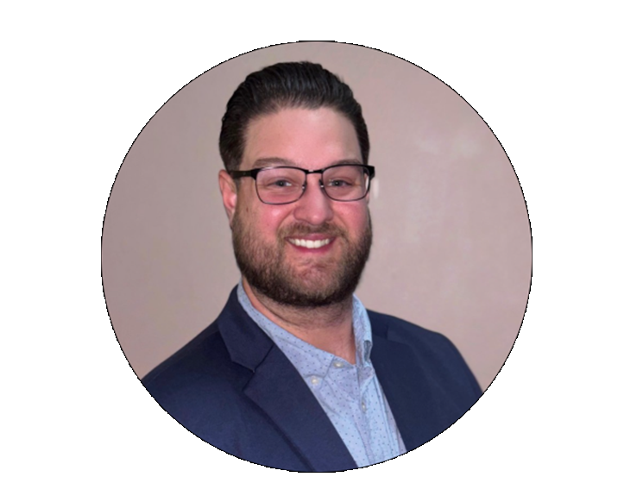
You Master of Ceremonies

Slide 3
Who or What is the IES?
An ANSI-Accredited Standards Developer (ASD)
Over 100 Lighting Standards Developed and Continuously Maintained
Including:
Lighting Science
Lighting Practice
Recommended Practice
Technical Memoranda
Lighting Measurement
All created and regularly reviewed and revised by technical committees comprised of IES members and experts.
Turned 120 years old this year!
Founded in 1906 in NYC
82 Local Sections
66 in USA
12 in Canada
2 in Mexico
1 in Columbia
1 in Middle East

Slide 4
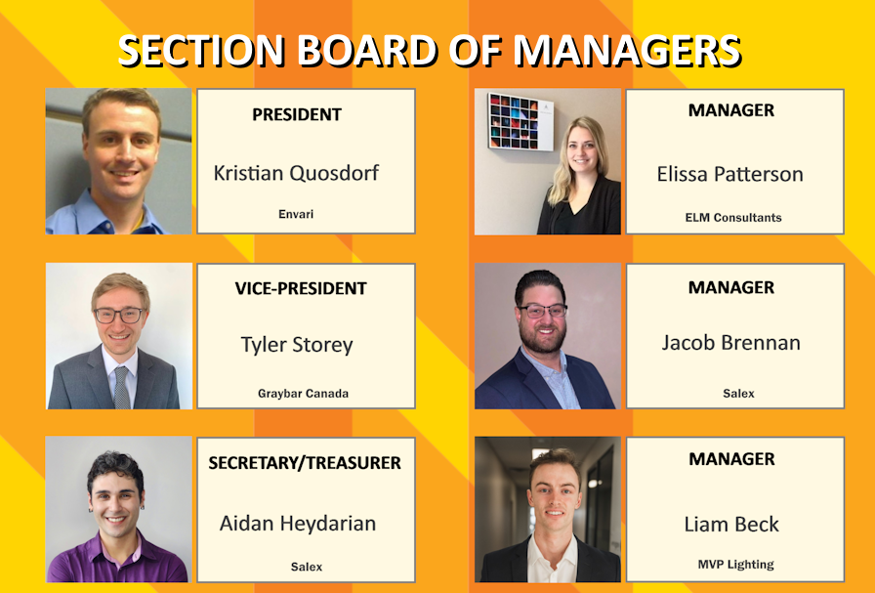
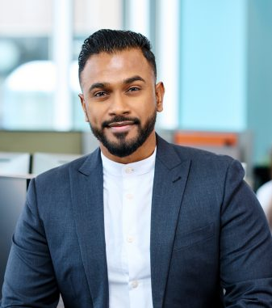
OUR IES SECTION BOARD OF MANAGERS
Kristian Quosdorf Section President
Tyler Storey Vice-President
Aidan Heydarian Treasurer and Gala Committee Chair
Elissa Patterson Manager
Jacob Brennan Manager and Membership Committee
Aidan Heydarian Treasurer and Gala Committee
Emerson Joekumar
Past Section President

Slide 5

Are you a Member?
Can members of the IES please stand up?

Slide 6
Why should you be a member?
Do you do lighting?
Sell lighting?
Purchase lighting?
Install lighting?
Maintaing lighting systems?
Practice lighting design?
Work at an electrical engineering firm?
Are you just beginning a career, but are interested in the above?
Do you sometimes ask questions about lighting?
Membership in The Illuminating Engineering Society can provide answers.

Slide 7
Individual IES Membership
Full Member
Emerging Professional Member
Anyone whose been in lighting for 5 years or more.
Anyone who is just starting their career or had not been involved with lighting in their previous role.
Must be less than 5 years in a lighting related role.
Must provide evidence that shows you qualify for this membership classification
Once 5 years of experience is reached, you will transfer to MEMBER grade.
USD $245 or about $345
USD $125
or about $175

Slide 8






Too Expensive ?
 | $95.88 | With ads
 | $119.88
 | $1,140.00 | TV Essentials+Internet (*special)
 | $479.88
 | 493.50 | 1 Med Double-Double per work day
$349.00
$ 2,678.14
Grande Caffè Latte from Starbucks
Once a week
Your employer may support your membership dues

Slide 9
Thank you
We hope you enjoy your evening

Slide 10
Volunteer Recognition
Presentation of
Past Section President Pin

Slide 11
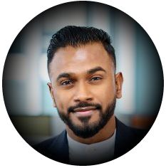
Emerson Joekumar
IES Ottawa
Section President
2023-2025

Slide 12
